Slide 1
Simple Harmonic Motion : SHM
10 ^{th} august 2020

Slide 2
A simple harmonic oscillator : simple pendulum
(Guessed) Solutions of the equation of motion
where A, B = arbitrary constants and ω = (g/l)^{1/2}
The combination; θ₁ + θ₂, becomes the general solution and can be written as
where
Small angle approximation is applied.
Notes:
Simple pendulum is an idealized system consisting of a massless inextensible string, fixed rigidly at one end, having a point mass at the other.
Combination ของ differential equation ที่ได้ยังคงเป็น harmonic function
The knowledge of the phase constant enables us to find out how far from the mean position the system was at time t = 0.
X = asin(wt+φ) where a =(A^2 + B^2)^1/2 and tanφ = A/B

Slide 3

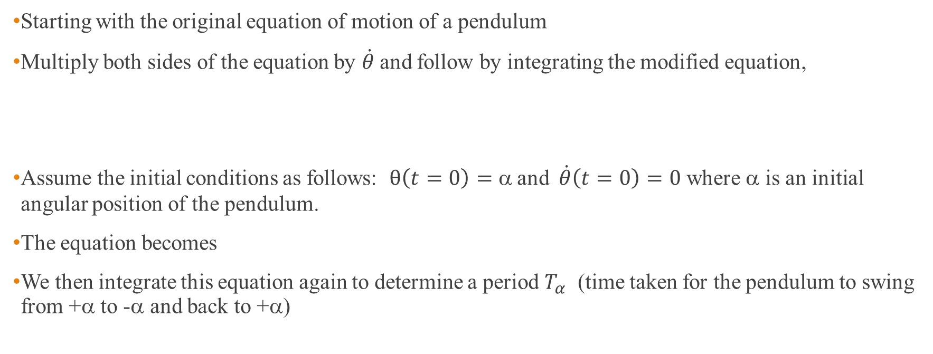
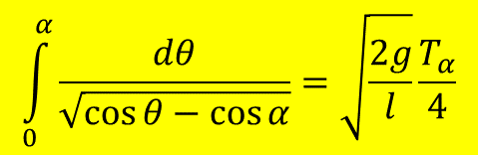
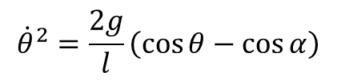
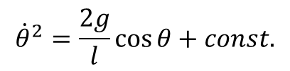
A pendulum with a large oscillating angle
$$\ddot{θ}+\frac{g}{l}\sin{θ}=0$$
Starting with the original equation of motion of a pendulum
Multiply both sides of the equation by $\dot{θ}$and follow by integrating the modified equation,
Assume the initial conditions as follows: $θ\left(t=0\right)=α$and $\dot{θ}\left(t=0\right)=0$ where α is an initial angular position of the pendulum.
The equation becomes
We then integrate this equation again to determine a period $T_{α}$ (time taken for the pendulum to swing from +α to -α and back to +α)
$${\dot{θ}}^{2}=\frac{2g}{l}\cos{θ}+const.$$
$${\dot{θ}}^{2}=\frac{2g}{l}\left(\cos{θ}−\cos{α}\right)$$
$$\int_{0}^{α}{\frac{dθ}{\sqrt{\cos{θ}−\cos{α}}}=\sqrt{\frac{2g}{l}}\frac{T_{α}}{4}}$$

Slide 4



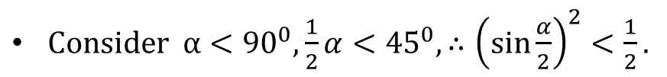

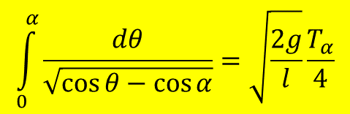
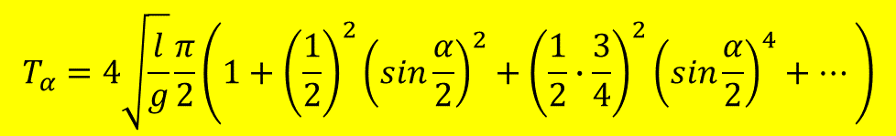
Complete elliptic integral of the 1st kind
$$T_{α}=4\sqrt{\frac{l}{g}}\int_{0}^{\frac{π}{2}}{\frac{dφ}{\sqrt{1−k^{2}\sin^{2}φ}}}$$
$$\int_{0}^{α}{\frac{dθ}{\sqrt{\cos{θ}−\cos{α}}}=\sqrt{\frac{2g}{l}}\frac{T_{α}}{4}}$$
We can transform into where $k=sin\frac{α}{2}$
which clearly show that the oscillating period depends on the angular position α and the length of the string l.
The derived expression corresponds to the complete elliptic integral of the 1st kind: $K\left(k\right)=\int_{0}^{\frac{π}{2}}{\frac{dθ}{\sqrt{1−k^{2}\sin^{2}θ}}}$, therefore period $T_{α}$ can be written as
$$T_{α}=4\sqrt{\frac{l}{g}}K\left(sin\frac{α}{2}\right)$$
$Consider α<{90}^{0}, \frac{1}{2}α<{45}^{0},∴{\left(\sin{\frac{α}{2}}\right)}^{2}<\frac{1}{2}.$
$$This gives k\sin{φ<1}.$$
What if the small angle approximation is applied to this expression!
$\frac{1}{\sqrt{1−k^{2}\sin^{2}φ}}$ can be binomial expanded and we end up with
$$T_{α}=4\sqrt{\frac{l}{g}}\frac{π}{2}\left(1+{\left(\frac{1}{2}\right)}^{2}{\left(sin\frac{α}{2}\right)}^{2}+{\left(\frac{1}{2}∙\frac{3}{4}\right)}^{2}{\left(sin\frac{α}{2}\right)}^{4}+⋯\right)$$

Slide 5
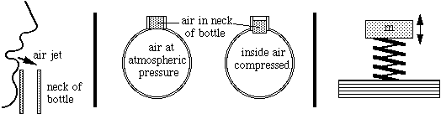
Example : Helmholtz Oscillator
A Helmholtz resonator or Helmholtz oscillator is a container of gas (usually air) with an open hole (or neck or port).
The vibrating part is a volume of air in and near the open hole because of the 'springiness' of the air inside.
https://newt.phys.unsw.edu.au/jw/Helmholtz.html
Notes:
The vibration here is due to the 'springiness' of air: when you compress it, its pressure increases and it tends to expand back to its original volume. Consider a 'lump' of air at the neck of the bottle (shaded in the middle diagrams and in the animation below). The air jet can force this lump of air a little way down the neck, thereby compressing the air inside. That pressure now drives the 'lump' of air out but, when it gets to its original position, its momentum takes it on outside the body a small distance. This rarifies the air inside the body, which then sucks the 'lump' of air back in. It can thus vibrate like a mass on a spring (diagram at right). The jet of air from your lips is capable of deflecting alternately into the bottle and outside, and that provides the power to keep the oscillation going
Vibration ของ air column เกิดจากความแตกต่างของความดันภายในกับความดันภายนอกของ oscillator ขณะที่ทำการเป่า

Slide 6
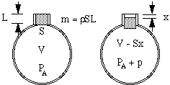
Analysis the Helmholtz oscillator (1)
The displacement of air column is given as x.
The change of air volume is Sx.
The change of pressure is p.
This creates an unbalanced force, pS, between the top and bottom of the neck.
Under the adiabatic process : PV^{γ} = constant.
∴dP/P = -γdV/V
Therefore, p/P_{A} = -γSx/V
L = effective length of air in the neck
S = cross sectional area
V =initial air volume
P_{A} = atmospheric pressure
ρ = air density
p = increasing pressure
Notes:
In the adiabatic process, there is no heat exchange between the system and the environment.
Because the heat transfer between the cycle (compression and rarefraction) is fast, heat transfer cannot occur and has to be kept in a cycle.

Slide 7
Analysis the Helmholtz oscillator (2)
Due to the pressure difference between the top and bottom of the neck, the motion of the air mass inside the neck follows the Newton’s laws of motion.
This leads to
Notes:
P = pressure difference between inside and outside resonator
Frequency proportional to area of opening port (longer opening gives higher frequency since air can rush in and out faster.
Frequency inversely proportional to the volume of cavity (larger volume gives lower frequency since more air must move out to relieve a given pressure excess),
Length of opening port (longer neck gives lower frequency since there is more resistance to air moving in and out.

Slide 8
Initial phase
Initial phase or phase constant is the phase at t = 0.
The knowledge of the phase constant enables us to find out how far from the mean position the system was at time t = 0.
The phase constant φ are determined from the initial conditions.
Notes:
Initial condition : the way the system is started at time t = 0.

Slide 9
Velocity and Acceleration in SHM
Displacement lags velocity by π/2 rad and is π rad out of phase with the acceleration.
The initial phase constant φ taken as zero.
a = amplitude
aω = velocity amplitude
aω² = acceleration amplitude
Notes:
Displacement lags velocity by pi/2 can be proved by substituting t = 0 and rewrite all function in the same from i.e. sine function.
X = a sin phi, v = awsin(phi + 90) and a = -aw^2sin(phi)

Slide 10
Energy of a Simple Harmonic Oscillator
The solution x = a sin(ωt + φ) reveals that the total energy of the oscillator must remain constant because the maximum displacement is regained after every half cycle.
Notes:
The given statement can be clarified by considering an oscillation example such as mass spring system.
According to the given displacement x = asin(wt + phi), the velocity is found to be wacos(wt+ phi)
The KE = 1/2mv^2 and PE = 1/2kx^2. The total mechanical energy is found to be 1/2w^2a^2m which is time independent.
The graph above clearly shows the variation of the each energy as a function of displacemnet

Slide 11
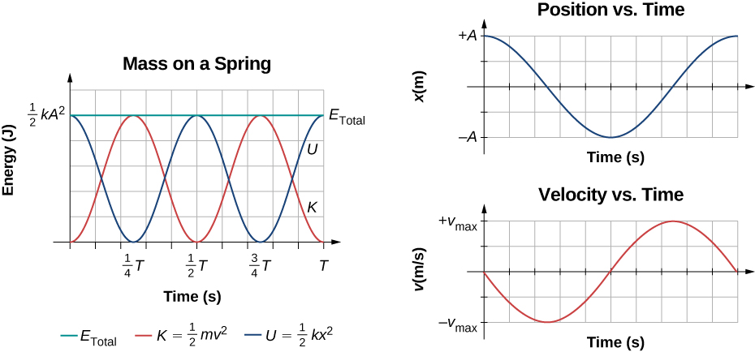
Graph of the kinetic energy, potential energy, and total energy of a block oscillating on a spring in SHM vs time
https://courses.lumenlearning.com/suny-osuniversityphysics/chapter/15-2-energy-in-simple-harmonic-motion/
Notes:
Also shown are the graphs of position versus time and velocity versus time. The total energy remains constant, but the energy oscillates between kinetic energy and potential energy. When the kinetic energy is maximum, the potential energy is zero. This occurs when the velocity is maximum and the mass is at the equilibrium position. The potential energy is maximum when the speed is zero. The total energy is the sum of the kinetic energy plus the potential energy and it is constant.

Slide 12
Example : Equation of motion by energy equation
The general form for the total energy of SHM is
  E = (1/2) mass (velocity)² + (1/2) stiffness (displacement)²
For the Helmholtz oscillator :
Mass of the air column = ……………… is displaced from equilibrium position by a distance of x.
The pressure change p =………….
The stiffness of the system is given by ……………………….
This equation of motion is found to be ……………………….
Notes:
mass of the air column = ρSL , The pressure change p = -γPSx/V. (S = cross sectional area)
The stiffness of the system γP_{A}S^2/V
dE/dt =0 = d/dt(1/2 ρSL v^2 + ½ γPS^2/v x^2) This then can be written as the equation of motion found in the Helmholtz resonator.

Slide 13
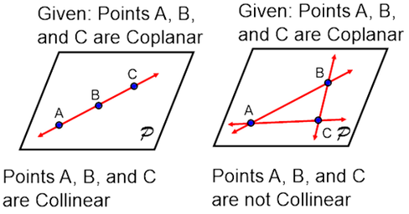
Superposition of Harmonic Oscillations
The superposition principle states that “ The resultant of two or more harmonic displacements is simply the algebraic sum of the individual displacement”.
The superposition principle holds only for linear differential equations, i.e.
a small oscillation with the equation of motion :
Consider superposition of
-Two simple harmonic vibrations in one dimension,
(Two collinear harmonic oscillations)
- Two perpendicular simple harmonic vibrations,
https://www.quora.com/Is-it-true-that-if-three-points-are-coplanar-they-are-collinear

Slide 14
Two Simple Harmonic Vibrations in One Dimension (1)
Two simple harmonic oscillations of equal angular frequencies but of different amplitudes and phases are given by
The algebraic sum of the two displacement is found to be
Note : the resulting motion is simple harmonic with an angular frequency ω, the same as that of the individual SHMs. The resulting motion has amplitude R and a phase constant θ.

Slide 15
Two Simple Harmonic Vibrations in One Dimension (2)
The resulting displacement can also be found from the addition of vectors.
By using the cosine law, the resulting amplitude R is given as
The phase constant of R is found to be
Consider at t = 0
Notes:
R can be determined either by vector addition or cosine law.

Slide 16
Two Simple Harmonic Vibrations in One Dimension (3)
Alternatively, the algebraic sum of the two harmonic functions can be written as

Slide 17
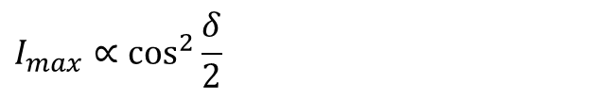
Example
The intensity of the pattern when light from two slits interferes will be seen to depend on the superposition of two simple harmonic oscillations of equal amplitude and phase difference δ. If intensity I = total amplitude squared.
Show that the maximum intensity is given by
$${I_{max}∝\cos^{2}{\frac{δ}{2}}}_{}$$

Slide 18

Suppose the electric field from each slit is given as
$$E_{total}=E_{1}+E_{2}=a\cos\left(ωt\right)+a\cos\left(ωt+δ\right)=R\cos\left(ωt+θ\right) \\ \text{ =}a\left(1+\cos{δ}\right)\cos{ω}t−a\sin{δ}\sin{ω}t \\ \text{define} R\cos{θ}=a\left(1+\cos{δ}\right) \\ \text{and} R\sin{θ}=a\sin{δ} \\ \text{this} \text{gives} R^{2}=2a^{2}\left(1+\cos{δ}\right) \text{and} \tan{θ}=\frac{\sin{δ}}{\left(1+\cos{δ}\right)} \\ \text{intensity} \text{is} \text{given} \text{by} I^{}=\left\langle E_{total}^{2}\right\rangle =R^{2}{\left\langle \cos^{2}\left(ωt+θ\right)\right\rangle }^{}{} \\ \text{ =}2a^{2}\cos^{2}\left(\frac{δ}{2}\right)$$
$∴I_{max}{∝\cos^{2}\left(\frac{δ}{2}\right)}_{}$

Slide 19
Two Simple Harmonic Vibrations in One Dimension (4)
Consider two vibrations of equal amplitudes but different frequencies,
The resulting displacement is given by
ω₂ - ω₁ is the beat frequency.

Slide 20
Superposition of two simple harmonic displacements with slightly different frequencies
The displacement graph shows the amplitude modulation of the high frequency components

Slide 21
Superposition of two perpendicular simple harmonic vibrations (1)
(1) Vibrations Having Equal Frequencies
  Two displacements in x and y axis
An expression, which is the general equation for an ellipse, involving only x and y and the constants φ₁ and φ₂
A₂
A₁
(derive this equation!)
A₁ and A₂ = semi major and semi minor axes
http://stackoverflow.com/questions/10322341/simple-algorithm-for-drawing-filled-ellipse-in-c-c

Slide 22
Superposition of two perpendicular simple harmonic vibrations (2)
Paths traced by a system vibrating simultaneously in two perpendicular directions with simple harmonic motions of equal frequency.
How to check the handedness?
Notes:
The rotation direction of circle or ellipse can be investigated using the two initial equations; ie., x = A1cos(wt) and y = A2cos(wt+delta)
If delta = 3pi/2, x = A1cos(wt) and y = +A2sinxt. The rotation of the resultant vector can be seen clearly by substituting two particular times which are
t = 0 and t = T/4. The resultant vectors corresponding to those times clearly rotate ccw.

Slide 23
The polarization transformation due to a linear light passing through a birefringence crystal can be determined from the superposition of two perpendicular harmonic vibrations. The final output polarization is a circularly polarized.

Slide 24
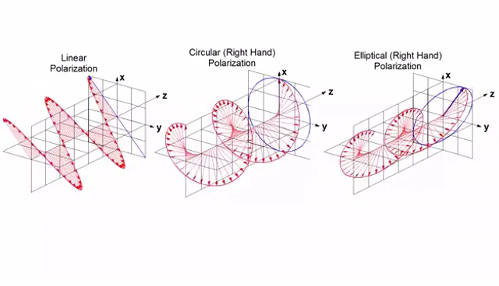
Polarization states
https://gfycat.com/dazzlingfirsthandblackrhino

Slide 25
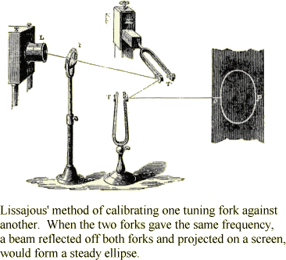
Superposition of two perpendicular simple harmonic vibrations (3)
(2) Vibrations Having Different Frequencies (Lissajous Figures)
An experimental setup made by Jules Antoine Lissajous to study the superposition of two perpendicular vibrations with different angular frequencies.
http://www.uh.edu/engines/musicforawhile/musictext.htm
Notes:
สังเกตว่าแนวการสั่นของ tuning forks ตั้งฉากกัน

Slide 26
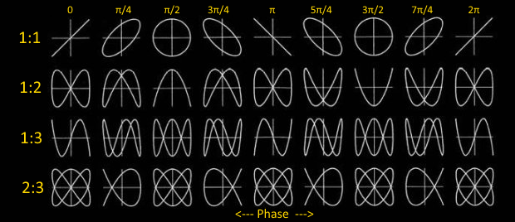
Lissajous figures
Frequency ratio
Identical frequencies in each component
http://datagenetics.com/blog/april22015/index.html

Slide 27
Simple harmonic oscillations in an electrical system
Electrical system which oscillates simple harmonically.
The sum of the voltage around the circuit is given by Kirchhoff’s loop rule
ω is considered as natural frequency of the circuit.

Slide 28
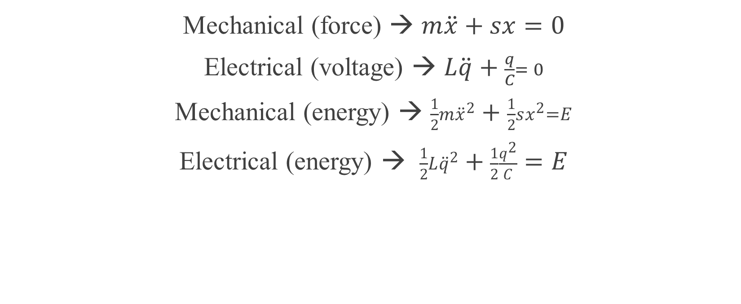
Comparison between the equations for mechanical and electrical oscillators
Mechanical (force) → $m\ddot{x}+sx=0$
Electrical (voltage) → $L\ddot{q}+\frac{q}{C}= 0$
Mechanical (energy) → $\frac{1}{2}m{\ddot{x}}^{2}+\frac{1}{2}sx^{2}=E$
Electrical (energy) → $\frac{1}{2}L{\ddot{q}}^{2}+\frac{1}{2}\frac{q^{2}}{C}=E$

Slide 29

Homework #1/2020
1. Show that can be transformed to
given that (1) $\cos{θ}=1−{2sin}^{2}\left(\frac{θ}{2}\right)$ , $\cos{α}=1−{2sin}^{2}\left(\frac{α}{2}\right)$
  (2) $sinφ=\frac{sin\frac{θ}{2}}{\sin{\frac{α}{2}}}$ and (3) $k=sin\frac{α}{2}$
2. Prove that can be derived from the superposition
of two perpendicular harmonic functions :

